Slide 1
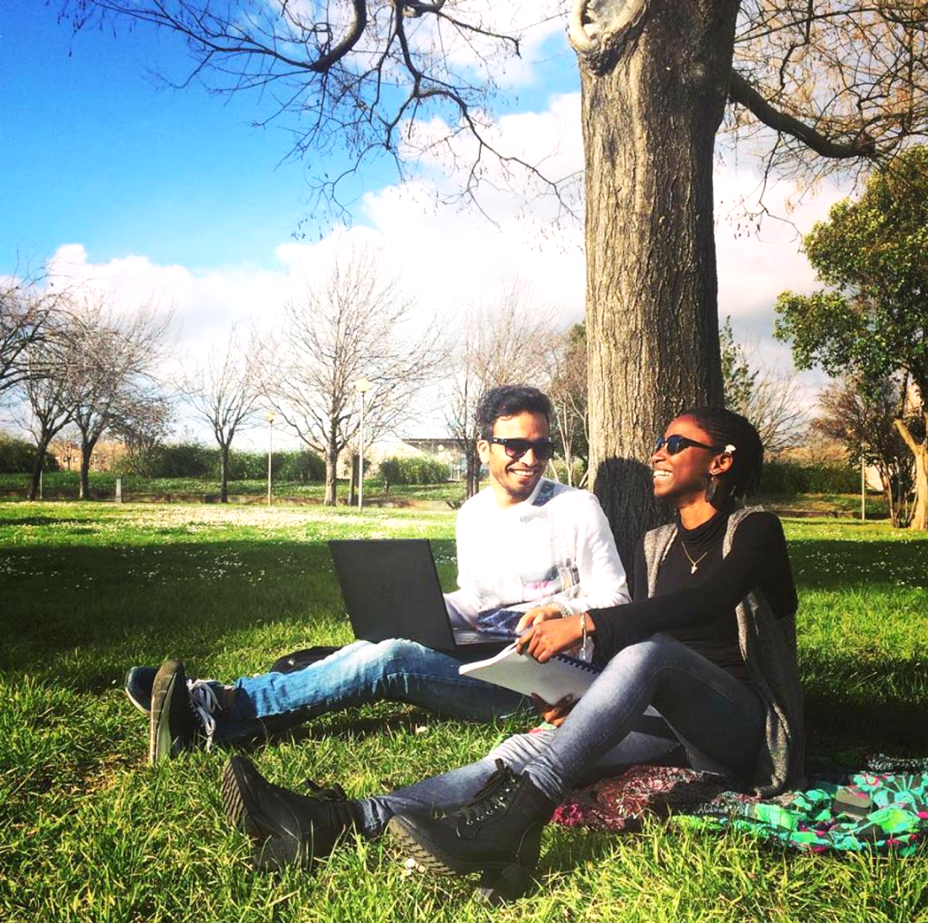
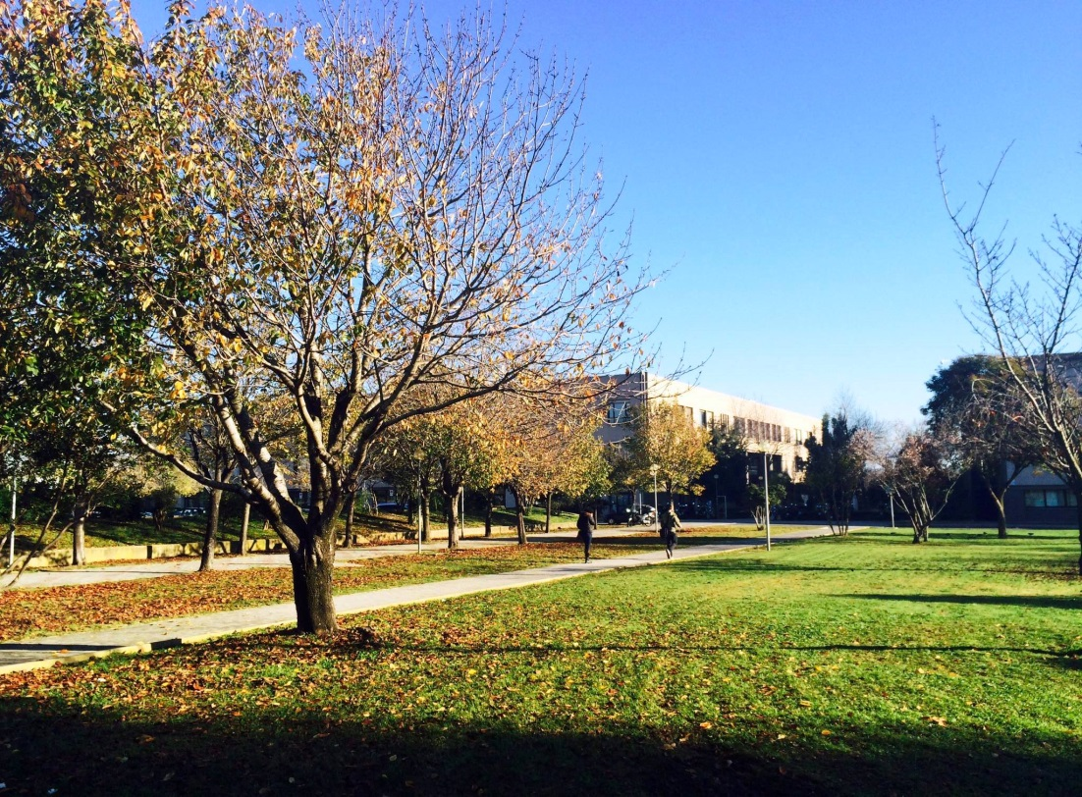

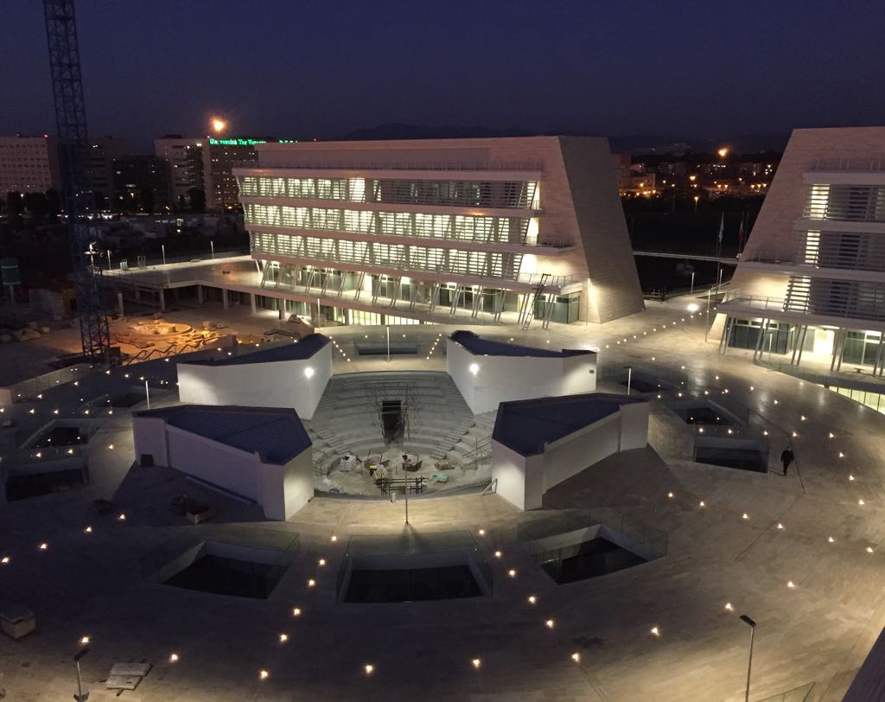
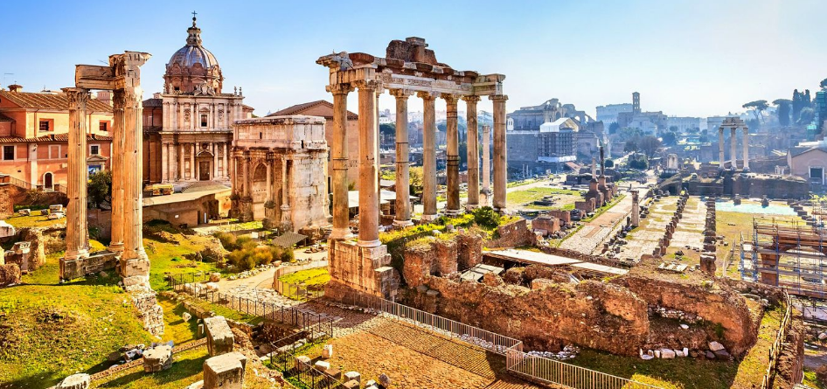
Monika’s Erasmus Network Meeting
Villa Mondragone – June 7th 2019

Slide 2

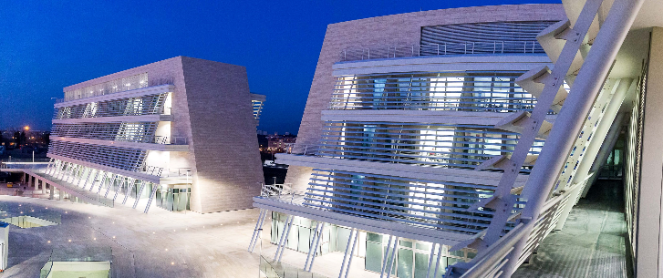
Who we are
The University of Rome Tor Vergata is a public University, established in 1982.

Slide 3



Our Goals
DIDACTICS
SUSTAINABLE DEVELOPMENT
To contribute to individuals’ education and training, to scientific research and to technological, organizational and social innovation in line with the 17 Sustainable Development Goals approved by the UN 2030 Agenda in September 2015, also through the cooperation with private sector, public non-profit institutions at the national and international level.
RESEARCH
THIRD MISSION
and our key words
& OURKEY WORDS
INTERNATIONALISATION
INNOVATION
INTERDISCIPLINARITY
TRANSDISCIPLINARITY
3
Notes:
Our Mission & Vision
We are convinced that the “2030 Agenda for sustainable development” (adopted by the United Nations General Assembly on 25 September 2015) has the power to unite an increasingly fractured society, to change mind-sets, to innovate a model of University, to promote a new paradigm for students, to leverage “better business for a better world”.
Our Key Words
INTERNATIONALISATION-INNOVATION (also social innovation), INTERDISCIPLINARITY, TRANSDISCIPLINARITY
Teaching and search for quality, internationalization, inter-disciplinary approach and Third Mission: these are our key words at Tor Vergata: a University that is open to the world, a campus dedicated to ground-breaking training, basic and applied research.

Slide 4

A new approach…
A new model
The way we innovate is changing.
The time has come to evaluate and to measure more precisely the contribution that the University can offer to achieve a better world and more sustainable future.
We must set ourselves the goal of maximizing
our generativity
Last but not least: creating social innovation.
Notes:
The way we innovate is changing.
We can measure our impact in terms of humanity. In terms of generativity:
Promoting a longer term vision with a sustainable development perspective in order to promote a new paradigm around the world, foster the new values (of tolerance, solidarity and intercultural dialogue) among young people;
Rebuilding trust by bringing people together around common goals;
Combining "know how to be" and "know how to make", favoring interdisciplinarity and transdisciplinarity;
Making networking and creating collaborative partnerships;
Promoting "contamination" with the industrial sector in order to create responsible ideas and products
Not least, making social innovation

Slide 5
Our actions
1
Increasing innovative and international educational programs and curricula
2
3
Creating bridges between Institutions, Firms and Society
Improving transnational and interdisciplinary research and developing selected Centers of Excellence

Slide 6
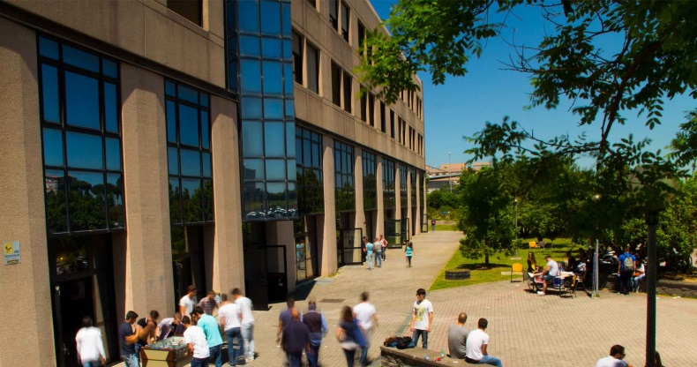
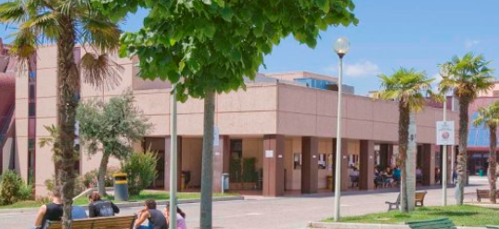
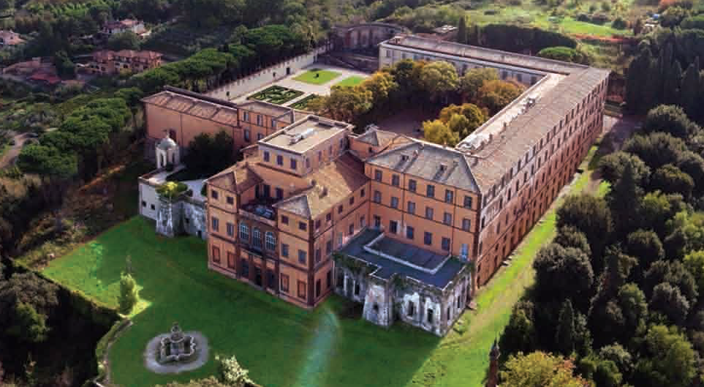
Facts and Figures
600-hectares campus
33.000 students
3.000 academic and administrative staff
6 Schools
18 Departments
6 libraries
29 computer labs
Conference centre Villa Mondragone
106 graduate programmes (A.Y. 2018-2019)
140 postgraduate courses
50 specialisation schools
32 PhD programmes
10% of the students enrolled from over 120 countries

Slide 7
Schools
SCHOOL OF ECONOMICS
Via Columbia, 2
www.economia.uniroma2.it
SCHOOL OF ENGINEERING
Via del Politecnico, 1
www.ing.uniroma2.it
SCHOOL OF MEDICINE AND SURGERY
and University Hospital
Via Montpellier, 1
www.med.uniroma2.it
SCHOOL OF MATHEMATICAL PHYSICAL AND NATURAL SCIENCES
Via della Ricerca Scientifica, 1
www.scienze.uniroma2.it
SCHOOL OF LAW
Via Cracovia
www.juris.uniroma2.it
SCHOOL OF HUMANITIES AND PHILOSOPHY
Via Columbia, 1
www.lettere.uniroma2.it

Slide 8
International degree courses
SCHOOL OF MEDICINE AND SURGERY
  - One cycle Degree in Medicine and
  Surgery
  -M.Sc. in Physical Activities and Health Promotion
SCHOOL OF ECONOMICS
  -B.A. in Global Governance
  -B.Sc. in Business Administration and Economics
  -M.Sc. in Business Administration
  -M.Sc. in Economics
  -M.Sc. in European Economy and Business Law -M.Sc. in Finance and banking
SCHOOL OF MATHEMATICAL PHYSICAL AND NATURAL SCIENCES
  - One cycle Degree in Pharmacy
  - M.Sc. in Biotechnology
  - M.Sc. in Physics (joint degree with curricula in English one of wich is Erasmus Mundus in Astrophysics)
  - M.Sc. in Physics, curriculum in English in Physics for Instrumentation and Technology
  - M.Sc. in Physics, curriculum in English in Physics of Complex Systems and Big Data
  - M.Sc. in Science and Technology of Materials (curriculum in English in Material for Photonics - Joint degree)
SCHOOL OF ENGINEERING
  -B. Sc. in Engineering Sciences
  -M.Sc. in ICT and Internet
  Engineering
  -M.Sc. in Chemistry for nano
  Engineering (new)
  -M. Sc. in Mechatronics (new)
SCHOOL OF HUMANITIES AND PHILOSOPHY
  -M.A. in History and Sources Studies (dual degree with curriculum in
  European History)
  -M.A. in Art History in Rome from Late Antiquity to the Present (new)

Slide 9

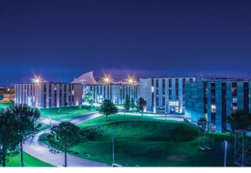
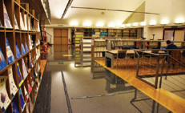
Services in Tor Vergata
Housing
Laziodisu (a regional body) provides students with scholarships and accomodation upon a
selection www.laziodisu.it
Campus X offering green areas and services with 1500 places www.campusx.it/roma/
Agevola Initiatives
Agevola gives the students the possibility of benefitting from more than 250 partnerships, oﬀers and discounts.
Check on www.agevola.uniroma2.it all the deals and discounts: restaurants, theatres, concerts, travels, gyms and much more.
Digital services
WiFi, free access to Microsoft Office 365, including an institutional e-mail account, OneDrive cloud workspace, Lync online, share points to create and share documents, Office web apps; online procedures to manage student careers; Matlab, Office365, Media Library online (MLOL, http://castelliromani.medialibrary.it/media/ricerca.aspx ), Digital-library, LabView (National Instruments), Microsoft Imagine Premium.
Check on http://docs2016.ccd.uniroma2.it/ to know how to have access to the services.
Library system and services
Each school has its own library offering Tor Vergata students a free access to soft and hard Copies.
Opening from 8.15 am to 12.00 pm (Monday-Friday); from 10 am to 8 pm (Sunday)
30

Slide 10
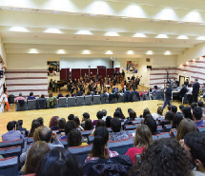
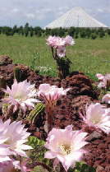
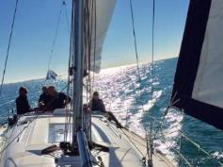
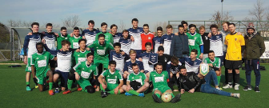
Leasure time…
University Sports Centre (CUS) Tor Vergata
Tor Vergata Sailing Club
Garden Golf University
«Archelogia per Roma» Museum
Botanic Garden
Music
Roma Sinfonietta and the Association of music today organize a season of concerts at the University of Rome Tor Vergata
Choir of Tor Vergata
www.uniroma2.it
32
Notes:
CUS oﬀers the opportunity to play sports at amateur and competitive level in many disciplines (11-a-side and 5-a-side soccer, basketball, cycling, judo, rugby, swimming, volleyball, tennis, athletics, weightlifting, karate, boxing, taekwondo, beach volleyball, canoeing, fighting, shooting, fencing, table tennis, etc.). CUS relies on technicians in Sport and Exercise Sciences providing advanced skills to achieve considerable results at a national and international level. Important successes in National Student Championships and World University Championships - where Tor Vergata students have won many medals - testify to this, as Daniele Garozzo, Medicine and Surgery’ student, wins gold medal men's fencing Rio Olympics 2016.
A Sports Festival and a Sports Culture Week are organised in May with the participation of thousands of students and visitors. They oﬀer a chance to rethink sports and physical activities as tools to promote wellness and health.
Garden golf:
The University of Rome Tor Vergata is the first Italian University and one of the few worldwide with a golf course. It is the first illuminated practice field in Rome featuring a golf school.
Tor Vergata Sailing Club: It is an amateur sports club where to practice sea sports and sailing sports.
Roma Sinfonietta and the Association of music today organise a season of concerts at the University of Rome Tor Vergata, Auditorium "Ennio Morricone" at the Macroaerea of Humanities
and Philosophy.
The 2016/2017 season has further expanded its range, embracing chamber music of the great composers and jazz, contemporary music theatre and traditional music of the Italian regions, the“bel canto” and tango, the music of medieval poems and meetings with today's composers.
If you like to sing, you can become part of the Choir of Tor Vergata founded in 1997 by Agostino Ziino, Professor of History of Music at the University of Rome Tor Vergata and its Artistic Director. Professors, students and technical staﬀ of the University take part in this project, which is oﬃcially recognised as the Ateneo Choir.
If you like playing music you can book a music rehersal space dedicated to music-making at Campus X!
Botanic garden:
The Botanic Garden of the University of Rome Tor Vergata (TVBG) was created in 2005 within the area of the university, on a surface of approximately 82 hectares, which makes it the biggest university Botanical Garden in Europe. It represents a new concept among botanical gardens, targeting several aims at the same time: didactic, research, innovation and support to industrial development. For that reason, TVBG has pursued four vocations, acting as a cultural, educational, social and scientific institution at once.
It is managed by a team of botanists together with professors and researchers from the Department of Biology belonging to the University of Rome Tor Vergata. www.bio.uniroma2.it/ortobotanico/
“Archeologia Per Roma” Museum is the first didactic and interactive museum of Archaeology in Rome. It oﬀers an original viewpoint on the whole of the Capital’s Archaeology describing a diﬀerent relationship between the City Centre and suburban areas. The programme schedules a number of didactic, cultural and leisure activities for both adults and children which are organised by CESTER, a University spin-oﬀ.
Entry to the Museum is free of charge. www.museoapr.it
Psychological Counseling and sex counseling service
The Psychological Counseling Centre provides students with information about their psychological and aptitude level using interviews and psychometric assessment.
The Sex Counseling Service, which is unique in Italy, free and open to the entire university community, has the aim to meet the help requests for sexual, emotional, or relational problems, as well as for sexual orientation, gender identity or for any abuse related to sexuality.

Slide 11
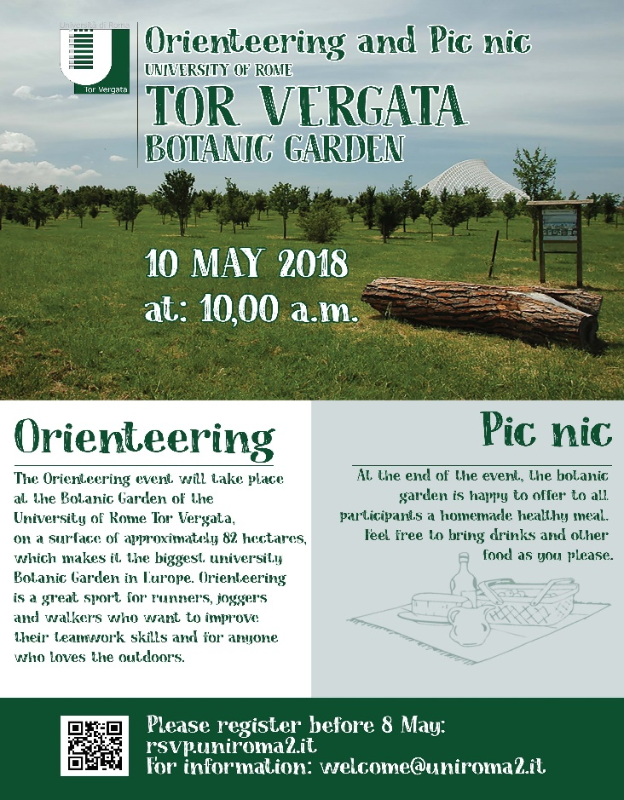
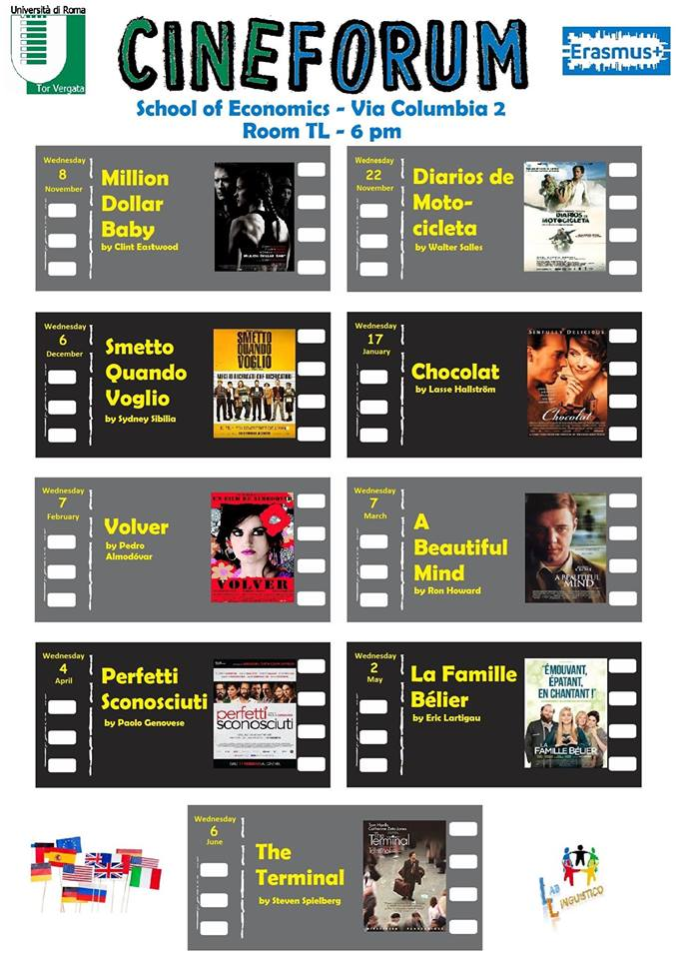

International events..
Cultural Excursion in cooperation with
Students Association
(i.e. Erasmus Students Association)
Notes:
University Language Centre (CLA)
Amongst its main aims, the Language Centre promotes multilingualism by
research in second language acquisition and educational technology.
under EU programmes (Erasmus+). Its activities are based on relevant
students enrolled at the University of Rome Tor Vergata as well as for those
Polish and Portuguese). It caters for curricular language courses for the
of seven foreign languages (English, French, Spanish, German, Russian,
The University Language Centre (CLA) supports the teaching and learning
Tor Vergata Shuttle service bus:
Two free shuttle buses are available for Tor Vergata community: one connects Tor Vergata railway station to the University buildings and the University buildings to each other. This service runs from 8.00 a.m to 06.00
p.m. from Monday to Friday. The second connects Anagnina underground station to the University buildings and the University buildings to each other. This service runs from 7.30 a.m. to 11.00. p.m. from Monday to Friday. On Sunday the service runs at 9.30 a.m. o’clock, 10.30 a.m., 07.30 p.m and
8.30 p.m. Routes and timetables are available on the University website: www.uniroma2.it
Tor Vergata Placement:
the University holds two important events for students and graduates to meet up with companies looking for talents. They are the University-Work Forum organised by Alitur, i.e. an Association of former Engineering students, and Campus&Leaders&Talents, set up by Desk Imprese and Associazione Laureati Economia Tor Vergata - Alet (Association of Tor Vergata Economics Graduates). These two events are held each year respectively in April and October, and the success of both initiatives is proven by the growing number of businesses and students attending such career days every year. www.placement.uniroma2.it

Slide 12


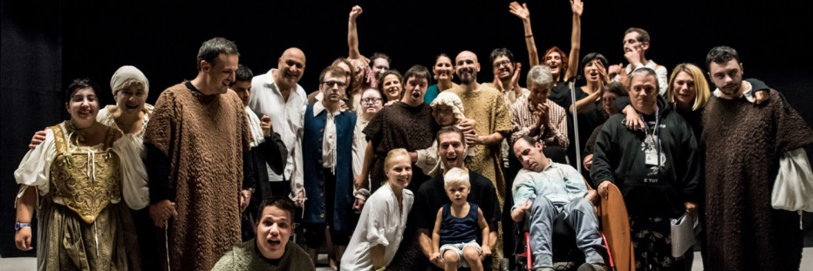
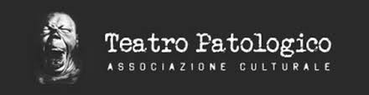

Third Mission and Social Innovation
BEYOND THE TRADITIONAL THIRD MISSION
We make
«social innovation»
PATHOLOGICAL THEATRE
PROMOTING A CULTURE FOR A INCLUSIVE SOCIETY
Example: THE INTEGRATED THEATRE OF EMOTION: an innovative research and educational program in theater arts for the mentally disabled
LINK video MEDEA https://vimeo.com/67211994
Notes:
It's a pilot innovative program in performing arts for the mentally handicapped which is gaining traction in Italy. The training program for the mentally disabled was instituted in 2016 at Tor Vergata and is supported by the university and Italian Ministry of University and Research (MIUR). The objective of the program is to offer training to the mentally disabled with mild to severe disabilities in all aspects of theater arts: acting, designing, writing, directing, music, and dance. The training is to empower them by unlocking their inherent talents through the arts and to provide them with a potentially sustainable way of living. The hope is that this approach has a broader application than conventional therapy that is aimed at normal functionality in society; rather it taps into the innate creative powers of each individual to give them dignity with and not despite their illness.

Slide 13
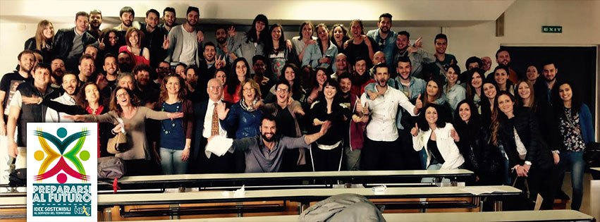

Third Mission and Social Innovation
THIRD MISSION AND SOCIAL INNOVATION
BEYOND THE TRADITIONAL THIRD MISSION
We make
«social innovation»
New Economy Labs
The NEW ECONOMY LABS aim to teach students a “new dimension of Social Responsibility” more attentive to the local needs and encouraging good practices exchange and implementation at local level.
CHANGE YOUR THINKING
& YOU WILL CHANGE THE WORLD
Notes:
In order to promote new cultural models

Slide 14


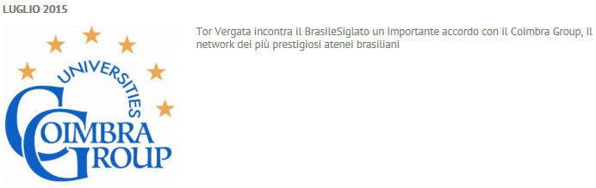



International Cooperation
Over 300 bilateral agreements with Partner Universities all over the world, extra-EU and top Universities in the BRICS Area
Over 500 Erasmus agreements in Europe
Member of Uni-Italia network
Member of International Networks:
EUA - European University Association
YERUN - Young European Research Universities Network
VIU - Venice International University
UNICA - Network of Universities from the Capitals of Europe
GCUB - Grupo Coimbra de Universidades Brasileiras
AAHCI - Association of Academic Health Centers International (AAHCI)

Slide 15

International Mobility
Marie Skłodowska-Curie Actions
Erasmus+
Overseas
Scholarships
Visiting Professor/Scholars
Programs
Final Dissertation
Scholarships
International Summer Schools
An Italian language course is available for all the incoming students at CLICI - Center for Italian Language and Culture of the University of Rome Tor Vergata -
at the beginning of each semester
www.scuolaiad.it
WELCOME WEEKS in September are organized to support incoming students at their arrival

Slide 16
Dual/Multiple/Joint Degree Courses
SCHOOL OF ECONOMICS
B.Sc. in Business Administration and Economics – dual degree with Skopje American College
- dual degree with High School of Economics - Saint Petersburg
B.A. in Gloobal Governance – dual degree with High School of Economics Saint Ptersburg
M.Sc. in Finance and Banking – dual degree with University of Gothenburg, Sweden
- dual degree with University of Konzminsky, Poland
M.Sc. in Economics – dual degree with University of Gothenburg, Sweden
– dual degree with University of Konstanz, Germany
M.Sc. in Business Administration – dual degree with Capital University of Economics and Business Beijing, China
SCHOOL OF HUMANITIES AND PHILOSOPHY
M.A. in European History – multiple degree with Universidad Complutense de Madrid, Tallinn University, Université Paris Diderot, University of Roma Tre, University College Dublin, King's College London, Freie Berlin University, Humboldt Berlin University, University of Vienna
B.A. in Languages for Information Society – dual degree with Université Catholique del Lille
M.A. in Philosophy – dual degree with Martin Luther University of Halle-Wittenberg
SCHOOL OF MATHEMATICAL PHYSICAL AND NATURAL SCIENCES
M.Sc. in Physics, curriculum in English in Astrophysics (Joint Master Degree Astromundus with Innsbruck, Goettinghen, Padova, Belgrade in Astronomy and Astrophysics)
M.Sc. in Science and Technology of Materials – dual degree with Technical University of Applied Sciences - Wildau
SCHOOL OF ENGINEERING
M.Sc. in Chemistry for nano Engineering – European Joint Master Degree

Slide 17
Dual/Multiple/Joint Degree Courses
Historical excursus….
The inter-governmental Bologna Process, launched in 1999 processes the
European Higher Education Area (EHEA)
Introduced transparency instruments to support student mobility:
European Credit Transfer System (ECTS)
Diploma Supplement
Prague 2001: Joint programmes have been encouraged by the Bologna Process
For the first time
Berlin 2003: Ministers explicitly agreed on supporting the development
and quality assurance of integrated curricula leading to joint degrees
The most officially recognised definitions in Europe are those made by the
inter-governmental, regional UNESCO Lisbon Recognition Convention,
in the Recommendation on the Recognition of Joint Degrees (2004)
2005 and in 2007: Joint programmes support various Bologna action lines,
such as student mobility, joint curriculum development and joint quality assurance

Slide 18
Dual/Multiple/Joint Degree Courses
Historical excursus….
Financial Support:
Joint curricula were initially supported in the Lifelong Learning Programme through Erasmus.
Later joint programme initiatives were financed through programmes such
as Erasmus Mundus, EU-USA Atlantis, EU-Canada, the ICI-ECP programme
with industrialised countries, and Tempus
For Latin America, the 2006 Asturias declaration stressed the development of joint
programmes as a priority area for higher education collaboration with EU countries,
and as a way to facilitate academic staff, researcher and student mobility
2009 Campus Asia programme was created, a regional initiative
similar to the European Erasmus Mundus with focus on joint programme
2010 Africa and Middle East developed a joint programmes as a tool of internationalization
with other countries

Slide 19
Dual/Multiple/Joint Degree Courses
Definitions…
Joint programme
• The programmes are jointly developed and/or approved by several institutions;
• Students from each participating institution study parts of the programme
at other institutions;
• The students' stays at the participating institutions are of comparable length;
• Periods of study and exams passed at the partner institution(s) are fully and
automatically recognised;
• Professors of each participating institution also teach at the other institutions,
jointly work out the curriculum, and form joint admission and examination commissions;
• After completion of the full programme, the student either obtains
the national degrees of each participating institution or a degree awarded jointly by them.

Slide 20
Dual/Multiple/Joint Degree Courses
Definitions…
Joint Degree
Joint programme created ex novo in the Institutions involved;
Structured mobility in the host institution: one, two or more
semesters;
All the students enrolled are involved in;
Degree award: one single joint degree issued by all institutions;
It needs the accreditation by the Ministry of Education
or by the National Accreditation Agency
- Tuition fees payed in both institutions by their own students

Slide 21
Dual/Multiple/Joint Degree Courses
Definitions…
Dual Degree
Joint programme created on existing degree programme;
Curricula abroad definited by institutions involved;
Recognition task needed;
Structured mobility in the host institution: two semesters;
Part of the students enrolled can be selected for the programme;
Degree award: the two national degree by the single institutions;
Doesn’t need the accreditation by the Ministry of Education
or by the National Accreditation Agency
- Tuition fee payed in the home institution

Slide 22
Dual/Multiple/Joint Degree Courses
Definitions…
The Diploma Supplement
- The European Diploma Supplement is a document
attached to a higher education diploma aimed at
improving transparency and facilitating recognition;
- It describes the nature, level, context, content and status
of the studies that were successfully completed by the individual
named on the original diploma to which this supplement is appended;
In case of joint/dual degree the Institutions involved issue a joint
diploma supplement

Slide 23
Dual/Multiple/Joint Degree Courses
Benefits:
At the institutional level:
• raise the international visibility and reputation of the institution;
• increase global student recruitment and the level of internationalization;
• raise institutional revenue by increasing foreign student enrolments;
• deepen and institutionalize cooperation with consortium partners and establish
more sustainable strategic relationships;
• build networks of excellence to strengthen (strategic) international research collaboration;
• improve the quality of the curriculum (and of research elements in the case
of joint doctoral programmes);
• increase cross-cultural competencies of students and staff, not only through mobility,
but also by enhancing internationalization at home;

Slide 24
Dual/Multiple/Joint Degree Courses
Benefits:
For Academics:
Reasons for academic staff to become involved in joint programmes are
that these programmes offer them:
• opportunities to learn about other contexts and teaching and learning methods;
• student diversity in the classroom;
• networks for future teaching collaboration;
• research contacts;
• professional development opportunities;
• intercultural competences.

Slide 25
Dual/Multiple/Joint Degree Courses
Benefits:
For Students:
• take advantage of an international jointly developed curriculum, combining academic
expertise available in different countries through a study programme guaranteeing
automatic recognition of the period spent abroad;
• joint programme is of higher quality than a common single degree programme,
given that the expertise of more than one institution;
• international experience get in a foreign countries, usually longer than a simple
exchange period;
• increase job opportunities for the access a new labor market without the long and hard
Diploma Recognition procedures

Slide 26
Dual Degree….design it
Development a dual degree: steps
Find the strategic partner with a similar programme;
Matching the programmes to define the year of mobility;
Set-up the legal framework: the agreement with a focus on:
    - eligibility criteria (number of ECTS gained, level of language);
    - period of mobility (second/third year);
    - number of students involved;
    - criteria for the final thesis;
    - management commission.
    Approval from the board of the institutions involved;
    Monitoring and further modifications if needed

Slide 27
Dual Degree….some example skopje..

Slide 28
Dual Degree….some example Kostanz..

Slide 29

Dual Degree Courses: before start..
Learning outcome goal
Flexibility
Recognition task
Close cooperation between
professors and administrative staff

Slide 30
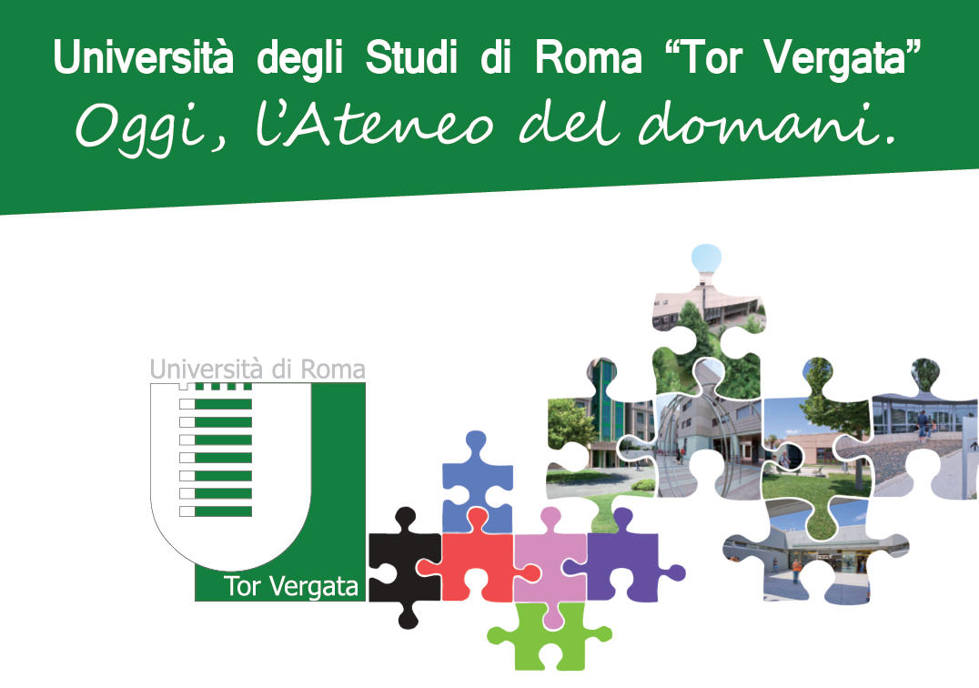
Thanks for your attention!
relazioni.internazionali@uniroma2.it
web.uniroma2.it

