Slide 1
A dream coming true.
EWP is bringing Erasmus administration into the 21st century by going digital
Luigi Gallo
Project Manager, Web Developer and Co-Founder @ Cantieri Informatici Srl

Slide 2
Cantieri Informatici Srl
http://www.cantierinformatici.com
The company was founded in 2000 by four Erasmus students
We all had working experience (scholarship holder) in the International Relation Office and in the Erasmus Association at Università degli Studi Roma Tre (helping incoming and outgoing students to find information, to find accomodation, organizing cultural visits, small trips, tandem, parties, …)
The main product at the beginning was a software, “Socrates Organizer”, now Erasmus+ Organizer (initially developed for Università degli Studi Roma Tre and Sapienza Università di Roma and later for Università degli Studi Tor Vergata, Università di Perugia, etc)
More similar software were developed to manage other mobility programs (Erasmus+ Traineeship, other Extra EU mobility programs).

Slide 3
The first Erasmus evolution 1999-2000
Thanks to Socrates Organizer and other similar software, almost contemporary and in many countries, Erasmus started migrating from paper to digital.
What does “Digital” mean? Back to the 2000, it meant that all the information was stored in a Database Server and served via a Web Server to the International Relation Office's Computers and Laptops.
The first evolution took effect only within the boundaries of the single university. At that time, the whole flow of documents and exchange of information between European universities remained unchanged (fax, mail, email, telephone).

Slide 4
Erasmus+ Organizer
A Swiss Knife, it has a tool for all the steps required to manage the Erasmus+ program.
It is fully integrated with the existing university IT System and Students Career Database
Main features:
Agreements and Erasmus scholarships management
Call document generation support
Online application for Outgoing Students (with data import from the university database)
Online application for Incoming Students (with the ability to enroll them and create WiFi and E-Mail account)
Rankings generation
Scholarship assignment tool and publication
Student’s private page
Document download/upload
Accept or renounce to the scholarship
Nominations
Online Learning Agreement/Change Form (similar to OLA, but integrated with the University’s Course Catalog)
Online signing of the Student Agreement
Incoming students immatriculation
Payment management
Transcript of Records management and exams registration/verbalization in the University’s students database
Reporting to the Mobility Tool

Slide 5
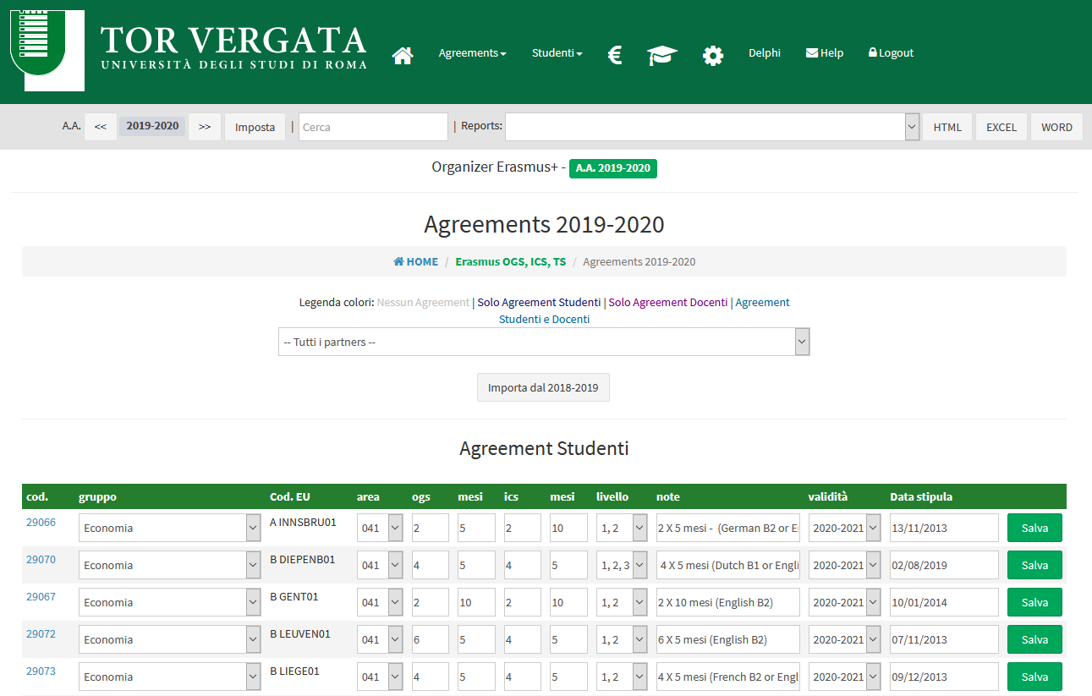
Erasmus+ Organizer

Slide 6
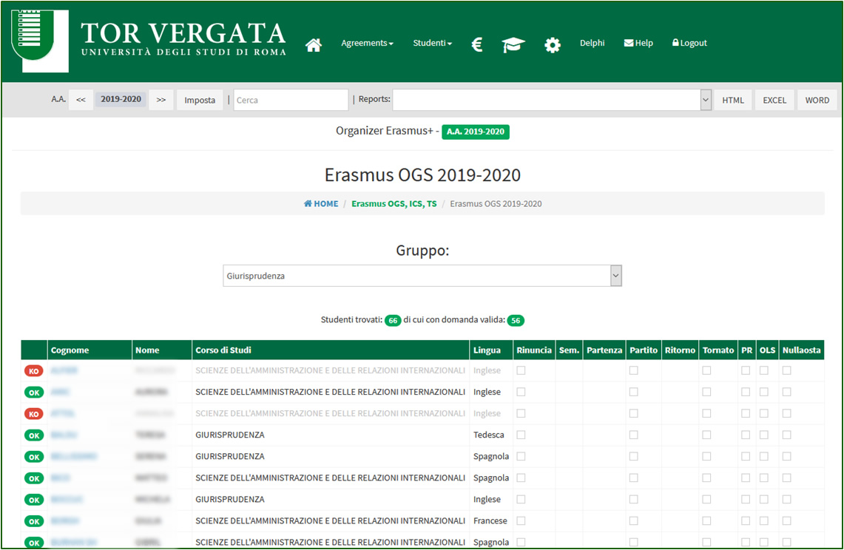
Erasmus+ Organizer

Slide 7
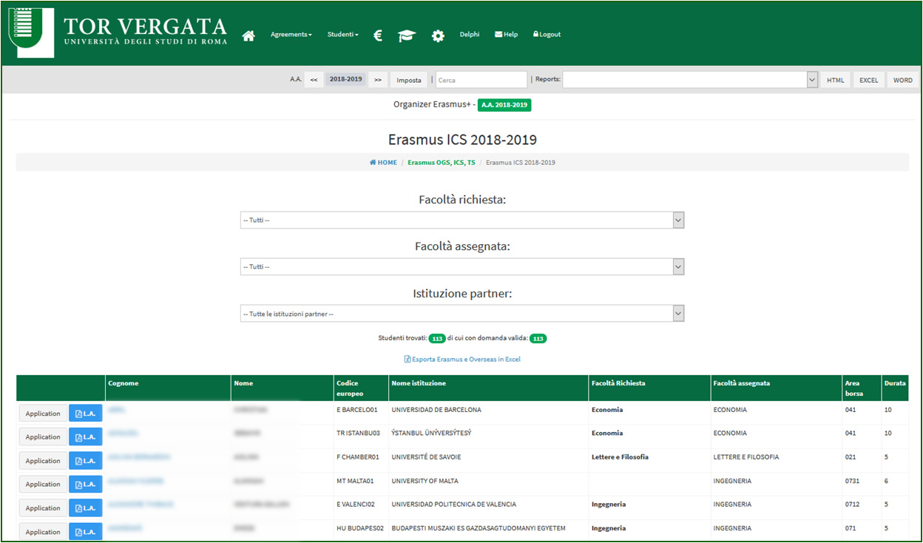
Erasmus+ Organizer

Slide 8
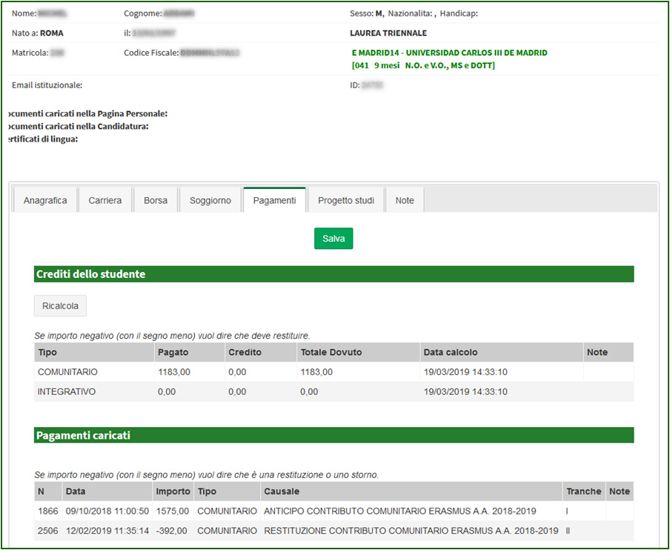
Erasmus+ Organizer

Slide 9
Erasmus+ Organizer
What’s next?
Erasmus Without Paper of course!

Slide 10
The second Erasmus evolution – Now!
EWP - Going ditigal, globally
Informations travel digitally in realtime and in a standard way, between universities all over Europe:
Info Sheet
Course Catalog
Departure dates
Incoming Students (actual arrival and departure dates)
Outgoing Students
Agreements
Learning Agreements
Transcript of Records

Slide 11
Cantieri Informatici, Erasmus+ Organizer and EWP

Slide 12
What is EWP?
EWP is an electronic network that European universities can join to exchange information related to the Erasmus + project in a digital way and realtime.
There is a single central register that contains only information on who adheres to and what information it shares.
All information (students, contacts, agreements, transcripts of records) are maintained and shared by the servers of the respective owners (masters).
Each university can share information (via API).
Each university can download information from other universities belonging to the EWP network

Slide 13
A simplified practical example to understand what EWP is
Central Registry
Tor Vergata needs to know which students will come to study from Madrid. Does the University of Madrid join EWP? It asks the Central Registry. And if so, what is the URL address of Madrid?
2) The Central Registry answers, “yes, it does”,
and responds with the address: https://madrid.uam.es/api/
Server Erasmus Tor Vergata
Server Erasmus Madrid
3) The Erasmus+ Organizer contacts the Madrid server and asks him for the nominations
4) The Madrid server responds with the list of students
5) Possible push notification from the Madrid Server to inform Erasmus+ Organizer that there are updated data

Slide 14
Each university can share information (through API) and download information (also though API).
What is the list of students who come to study at Tor Vergata?
Erasmus+ Organizer
Erasmus+ Organizer
Madrid students list
Institutions API
Server Erasmus Madrid
Institutions API
Organizational Units API
Organizational Units API
Course API
Course API
What is the list of students who come to study in Madrid?
Simple Course Replication API
Server Erasmus Tor Vergata
Simple Course Replication API
Outgoing Mobilities API
Outgoing Mobilities API
Learning Agreement API
Learning Agreement API
Tor Vergata students list
Incoming Mobilities API
Incoming Mobilities API
Incoming Mobility ToRs API
Incoming Mobility ToRs API
Interinstitutional Agreements API
Interinstitutional Agreements API

Slide 15
API List
Let's see a quick overview of the EWP API:
Institution API
Organizational Unit API
Course API
Simple Course Replication API
Interinstitutional Agreements (IIAs) API
Outgoing Mobilities API
Outgoing Mobility Learning Agreements API
Incoming Mobilities API
Incoming Mobilities ToR API
For each of these it is possible to implement a further respective API to manage and receive push notifications (CNR - Change Notification Receiver) which indicate if there are updates on the respective data.
Other API:
Mobility Tool+ APIs

Slide 16
Institution API
Description:
It allows you to share information about the University, ie contact details, contacts, logo, list of departments and more.
It also allows you to share the Fact Sheet PDF, a kind of business card normally sent to Erasmus partners via various channels.
API Documentation:
https://github.com/erasmus-without-paper/ewp-specs-api-mt-institutions/tree/v0.1.0

Slide 17
Organizational Unit API
Description:
It allows you to share information regarding the individual departments of the University.
Useful when, for example, the university wants to know and download the list of departments of the Partner to be able to specify for an agreement which is the reference department.
API Documentation :
https://github.com/erasmus-without-paper/ewp-specs-api-ounits/tree/v2.1.0

Slide 18
Simple Course Replication API
Description:
It gives the university the possibility to download locally the entire training offer of the Partner (or to the partners to download the university one) and then eventually integrate it in the compilation of the Learning Agreement through a search engine.
API Documentation:
https://github.com/erasmus-without-paper/ewp-specs-api-course-replication

Slide 19
Course API
Description:
It allows the university to search for information on one or more courses by searching for the course identification code. Or the Partners to look for info on university courses.
Useful for example when, while the student is completing his Learning Agreement, he enters the course code in Madrid and the information on the same is automatically downloaded and inserted into the web form.
API Documentation:
https://github.com/erasmus-without-paper/ewp-specs-api-courses/tree/v0.7.1

Slide 20
API - Accordi Erasmus (Interinstitutional Agreements (IIAs) API)
Description:
It allows the university to download the Agreements entered by each partner in order to compare them with their respective partners to check if there are discrepancies. Same thing from the Partner's point of view.
(Probably to be left on standby, considering the possible new version of this API to manage the introduction of the new EVA platform - Erasmus + Virtual Assistant for the renewal of inter-institutional agreements.)
API Documentation:
https://github.com/erasmus-without-paper/ewp-specs-api-course-replication

Slide 21
Outgoing Mobilities API
Description
It allows the university to download, from the participating Partners, the summary data (name, surname, email, date of birth, sex, nationality, photo) of the Erasmus students who will come to study at the university (Nomination).
API Documentation:
https://github.com/erasmus-without-paper/ewp-specs-api-omobilities/tree/v0.15.0

Slide 22
Outgoing Mobility Learning Agreements API
Description
It allows the university and the students to manage their Learning Agreements, intermediate and final, with a flow to manage the approvals of coordinators from both parties. Probably to be left on standby in view of a new version of this API to manage integration with a new dedicated system, OLA - Online Learning Agreement.
API Documentation:
https://github.com/erasmus-without-paper/ewp-specs-api-omobility-la-cnr/tree/v0.1.0

Slide 23
Incoming Mobilities API
Description:
It is used to share with the Partner if the student has been accepted or rejected and the dates of stay of foreign students, replacing the certificate of arrival and attendance.
API Documentation:
https://github.com/erasmus-without-paper/ewp-specs-api-imobilities/tree/v0.3.0

Slide 24
API – Transcript Of Records
Description:
It is used by the university to share with students the Transcripts Of Records of the students and to download the ToR of its students who have gone to study at the Partners participating in EWP.
API Documentation:
https://github.com/erasmus-without-paper/ewp-specs-api-imobility-tors/tree/v0.7.0

Slide 25
Thank you for your attention!
Luigi Gallo
Cantieri Informatici Srl
http://www.cantierinformatici.com
gallo@cantierinformatici.com

